Slide 1
EXCEL TASK1 SINGLE LAYOUT

Slide 2
CREATE DM
UPLOAD TO MS EXCEL
INSERT-> TABLE, CREATE A TABLE
INCLUDE THE FIEDS that are required
FILL COLOR IN table COLUMN NAME (TO DIFFERENCIATE BETWEEN HEADER COLUMN NAME & DATA cells)
AND THEN CONTINUE THE PROCESS AS SAID IN FURTHER SLIDES

Slide 3
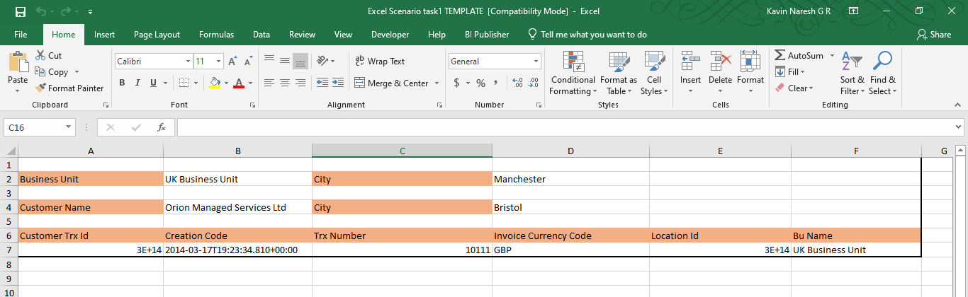

Select this area. Click repeating group in Bi publisher, a small window
Will pop-up. Select dataset as G_1 & group-by as BU_NAME.
Click ok.
To refer the template :click here to open excel file

Slide 4
Select this area. Click repeating group in Bi publisher, a small window
Will pop-up. Select dataset as G_1 & group-by as CUTOMER_NAME or VENDOR_NAME(depends upon module you choose).
Click ok.

Slide 5
Select this area. Click repeating group in Bi publisher, a small window
Will pop-up. Select dataset as G_1 & group-by as NULL.
Click ok.

Slide 6
To preview :
In BI Publisher, click Excel preview to verify the correctness of layout.
Next to see all the output:
Goto Oracle Instance. create a report with the datamodel selected. Upload the template & SAVE & VIEW REPORT. Select the required BU or you can select ALL to get all BU’s data in single Excel file.
Important Note: you can also select required BU and click APPLY in the parameter of BU ->to get single BU’s Customer/Supplier details.

